Slide 1
Binary Human-written vs Machine-generated text classification
Presented by Paolo De Angelis, Edoardo Merli, Giacomo Piergentili, Lorenzo Scaioli

Slide 2

Problem definition
SemEval 2024 – Task 8: Black-Box Machine-Generated Text Detection (English language)
Given an input text, classify it as either human-written or machine-generated
Motivation: tackle a different problem, while it still being really relevant and of interest

Slide 3
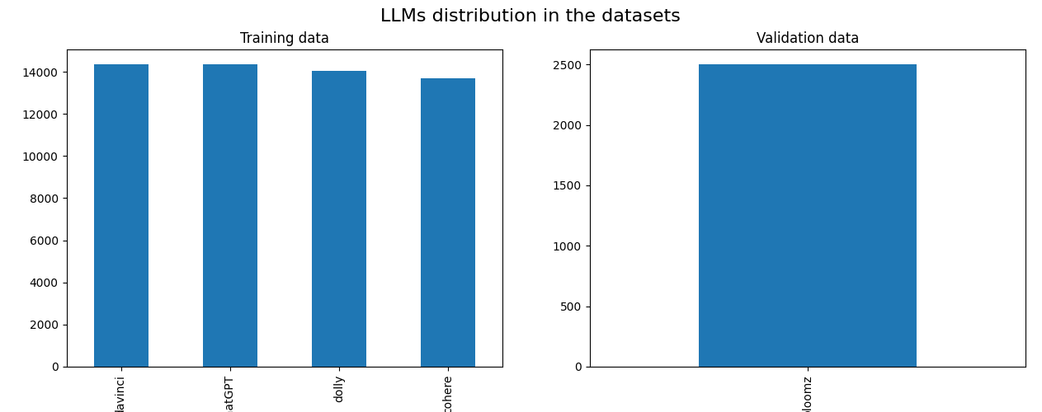
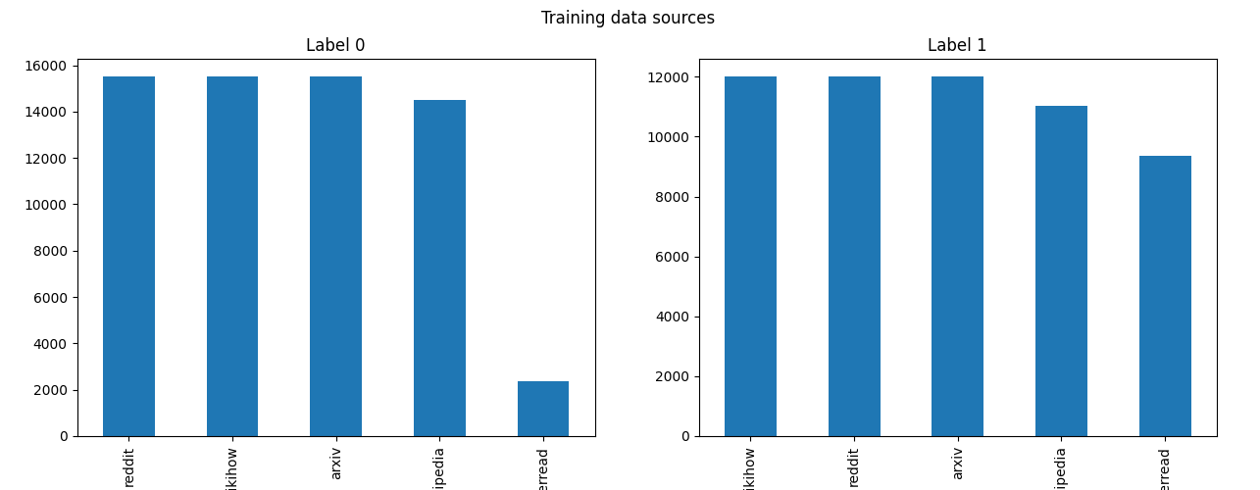
Data
Extension of the M4 dataset
Splits:
Train: 120K
Validation: 5K
Test: 34K
All approximately balanced
Train LLMs: DaVinci, ChatGPT, Dolly, Cohere
Validation LLM: BLOOMZ
Test LLMs: unknown
Sources/domains: Wikipedia, WikiHow, Reddit, arXiv, PeerRead
Metrics: accuracy and F1-score

Slide 4
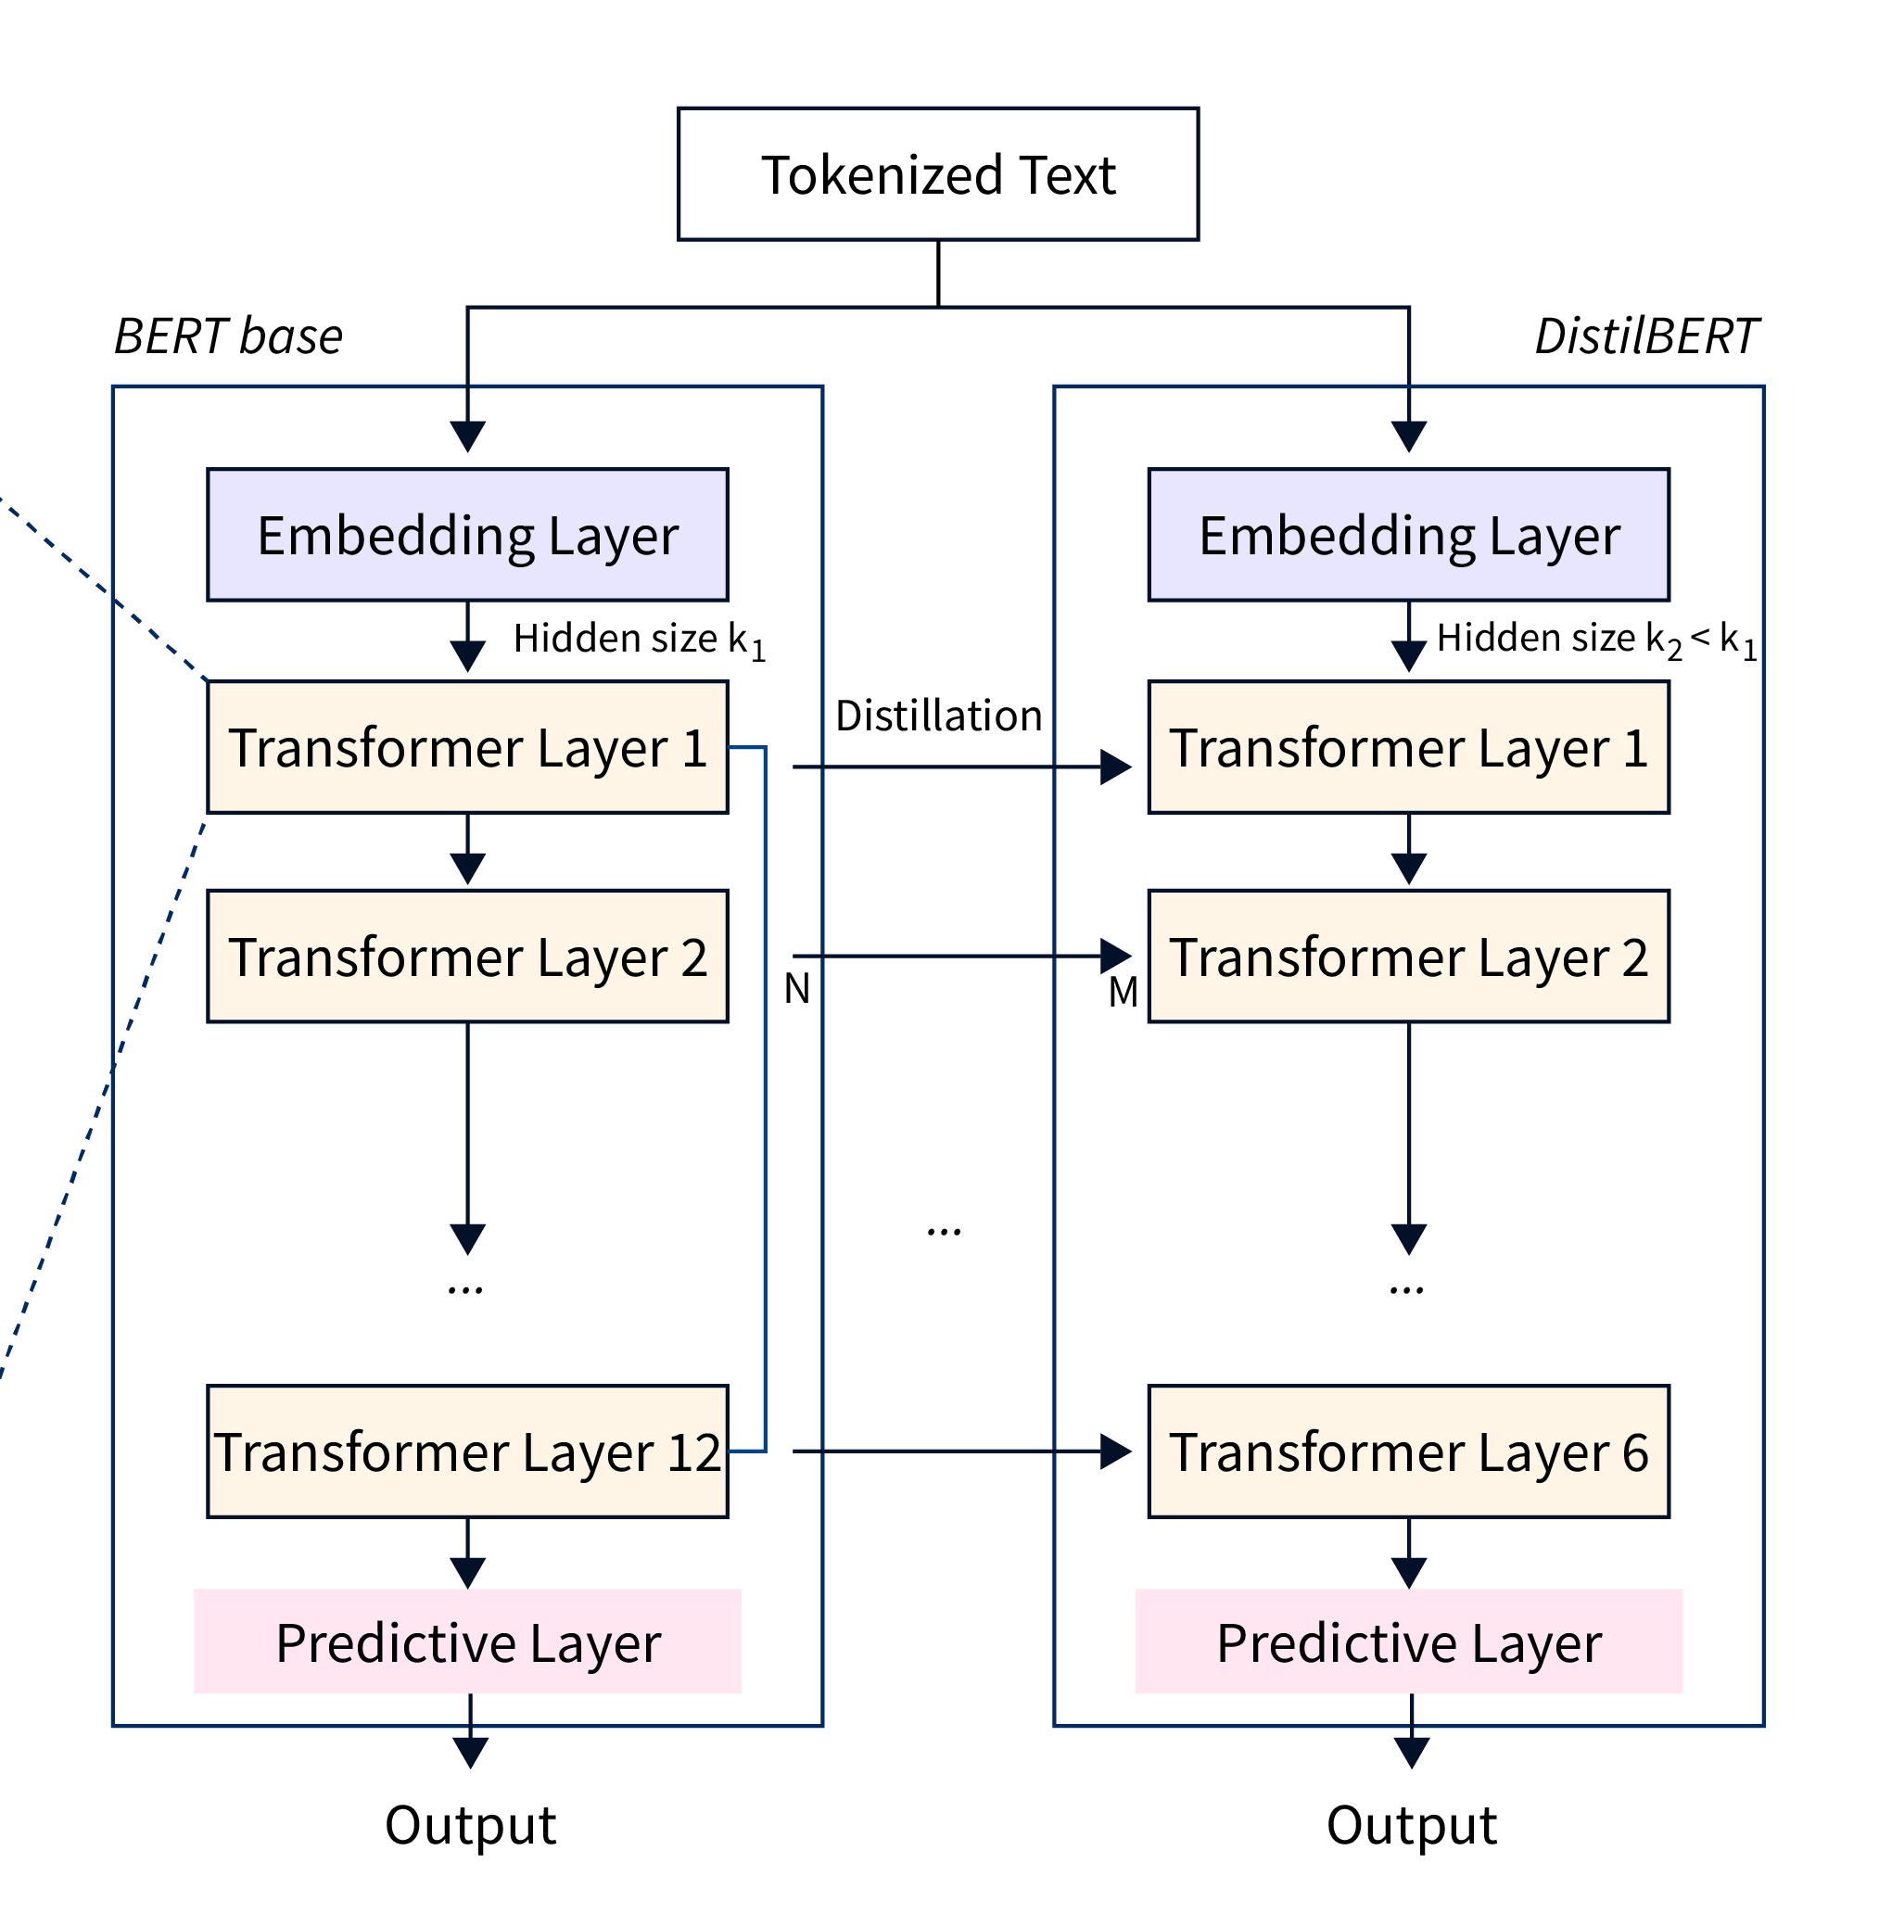
Baselines: DistilBERT
Pre-trained using distillation using BERT as teacher
Used in two versions:
with frozen backbone
with fully fine-tuned backbone
Chosen as baseline since computationally impractical to fully fine-tune BERT on 120K datapoints for 5 seeds (on top of all other models)

Slide 5
First approach: Custom tokenizer + TF-IDF + ML models
Tokenizer fit to target dataset (validation or test) to learn vocabulary.
Also evaluated an ensemble of the three ML models, to see the effect of reducing variance.
Multinomial
Naive-Bayes
BPE Tokenizer
TF-IDF
features
SVM
SVM
(SGD trained)

Slide 6
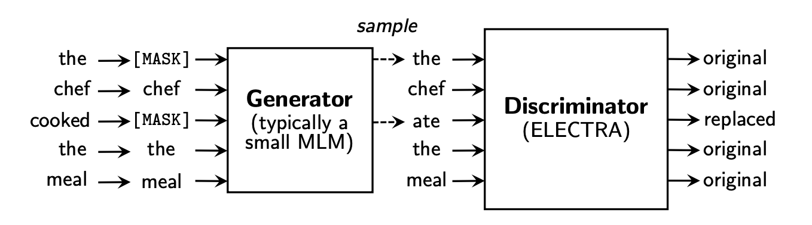
DeBERTaV3-Large with “subset” dataset…
Biggest Transformer Language Model we were able to train on the 2 x 16GB T4 GPUs provided by Kaggle (463M parameters).
For practical purposes (mainly training time), trained it on a balanced subset (with respect to “source”) of the training dataset:
24K training texts = 20% of original testset
DeBERTa
“V3” meaning

Slide 7
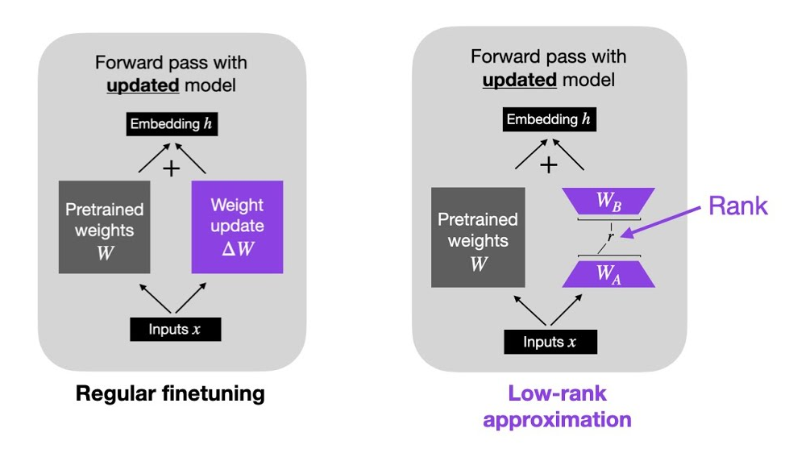
…or with LoRA
We wanted to also see the effects of scaling the amount of training data on the largest
model, DeBERTaV3-Large. To do so, we resolved to using Low-Rank Adaptation
Managed to reduce the number of parameters updated from 463M down to 28M (≈ 6%),
with negligible performance loss (-0.009 val acc, -0.017 test acc)

Slide 8
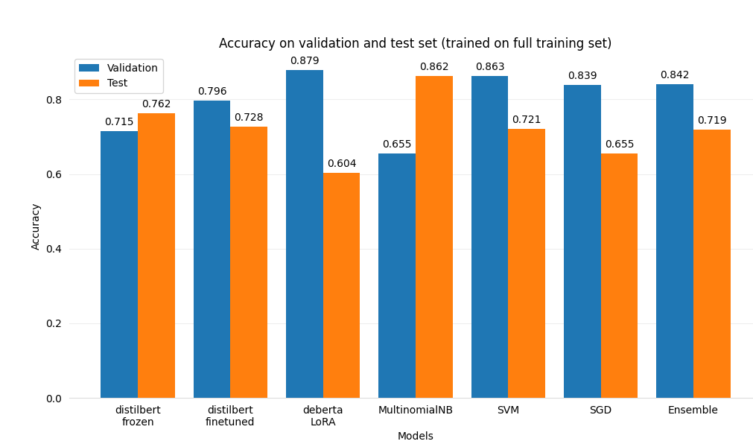
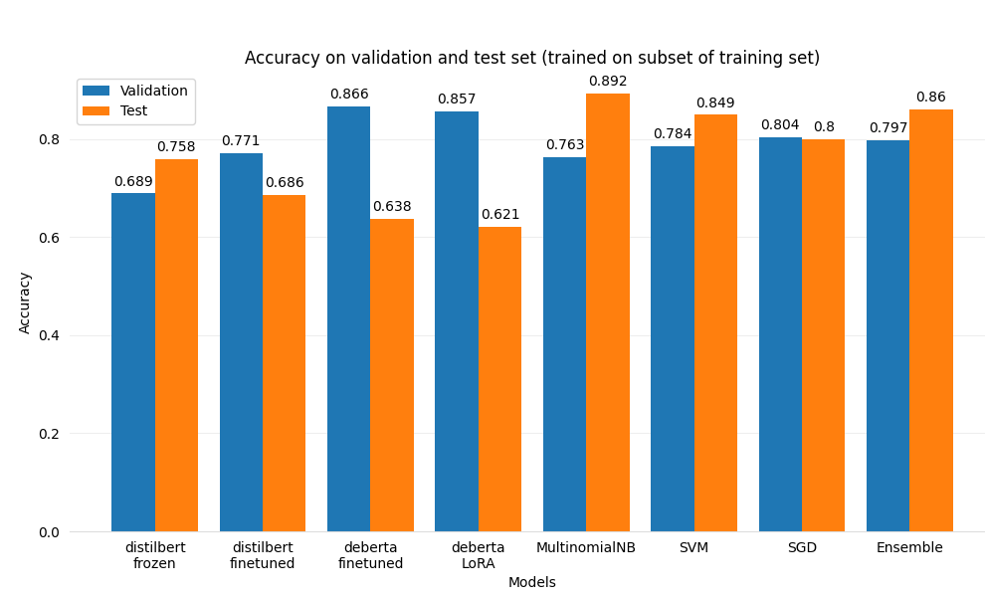
Results
FULL
TRAINING SET
SUBSET TRAINING SET

Slide 9
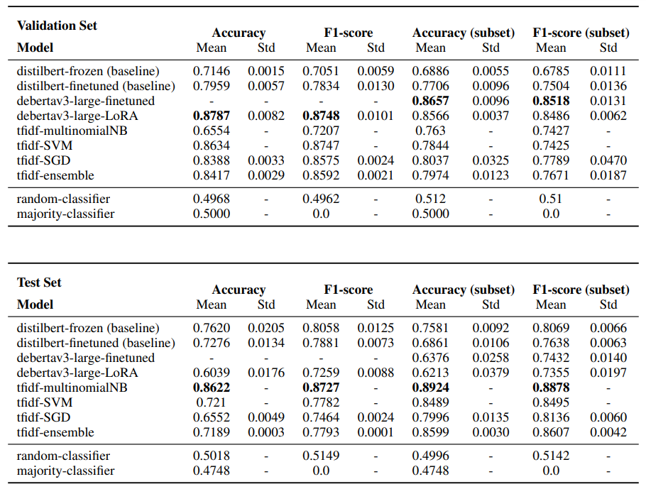
Results

Slide 10
Qualitative error analysis
‘Raxibacumab is a human monoclonal antibody intended for the prophylaxis and treatment of inhaled anthrax. Its efficacy has been proven in rabbits and monkeys. In December 2012 raxibacumab was approved in the United States for the treatment of inhalational anthrax due to Bacillus anthracis in combination with appropriate antibacterial drugs, and for prophylaxis of inhalational anthrax when alternative therapies are not available or are not appropriate.\n\nThe antibody was discovered in a joint venture between Cambridge Antibody Technology and Human Genome Sciences. Cambridge Antibody Technology discovered the antibody to Human Genome Sciences\'s target and, in 2012, HGS were purchased by GlaxoSmithKline (GSK). In 2017, it was acquired by Emergent BioSolutions\n\nSide effects \n\nThe most commonly observed adverse events are headaches, upper respiratory tract infection, nausea, pain in extremity and pruritus skin itching.\n\nPharmacology \n\nRaxibacumab injection is a monoclonal antibody targeting the protective antigen (PA) component of the lethal toxin of Bacillus anthracis.[…]’
Ground truth: HUMAN-WRITTEN
Prediction:
MACHINE-GENERATED
Source: Wikipedia

Slide 11
Conclusions
Our hypothesis: given the antipodal results between validation and test set, we believe that the test set could be from a considerably different distribution from the training set, making low-bias models perform worse (see DeBERTaV3 series). Next step: validate this hypothesis numerically.
Ideas to improve Transformers models performance:
Explore regularization techniques to reduce variance (connected to hypothesis above)
As only the first 512 tokens of each text are used: to consider the whole text, could run the model on each 512 tokens portion of the text, then average predictions.

Slide 12
Thank you for your attention!

Slide 13
Extra

Slide 14
In general, more FALSE POSITIVES than FALSE NEGATIVES errors across models

